Slide 1
https://powercybertestbed.ece.iastate.edu/
PUSH ALL WORK TO GITLAB AND IN VM!!!!!1!!!

Slide 2
Week 2

Slide 3
Who are Present Today
Matt, Justin, Kaya, Zach, Tommy, Tyler

Slide 4
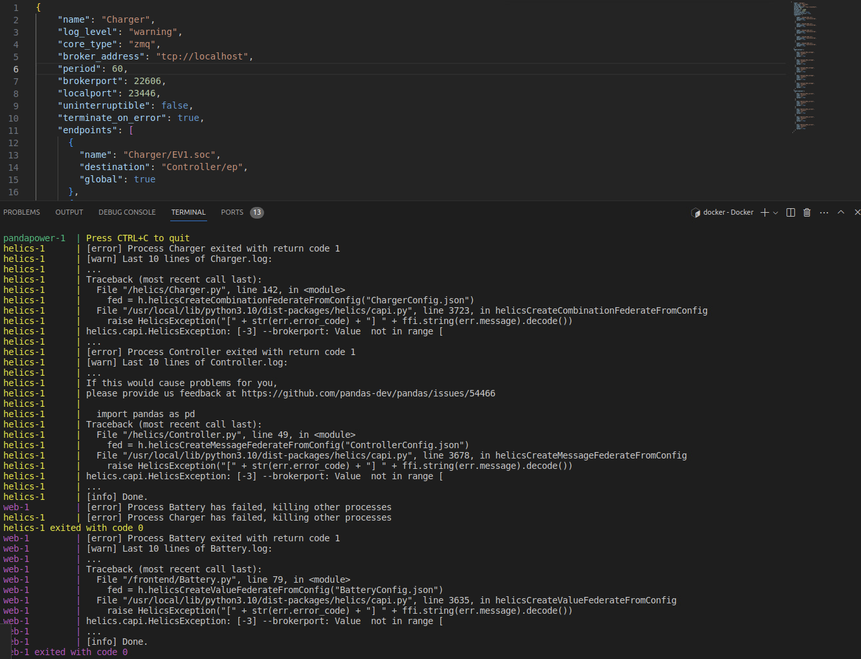
Justin - Work
Making Progress on the Docker stuff and HELICS
Tons of questions when it comes to the port configuration

Slide 5
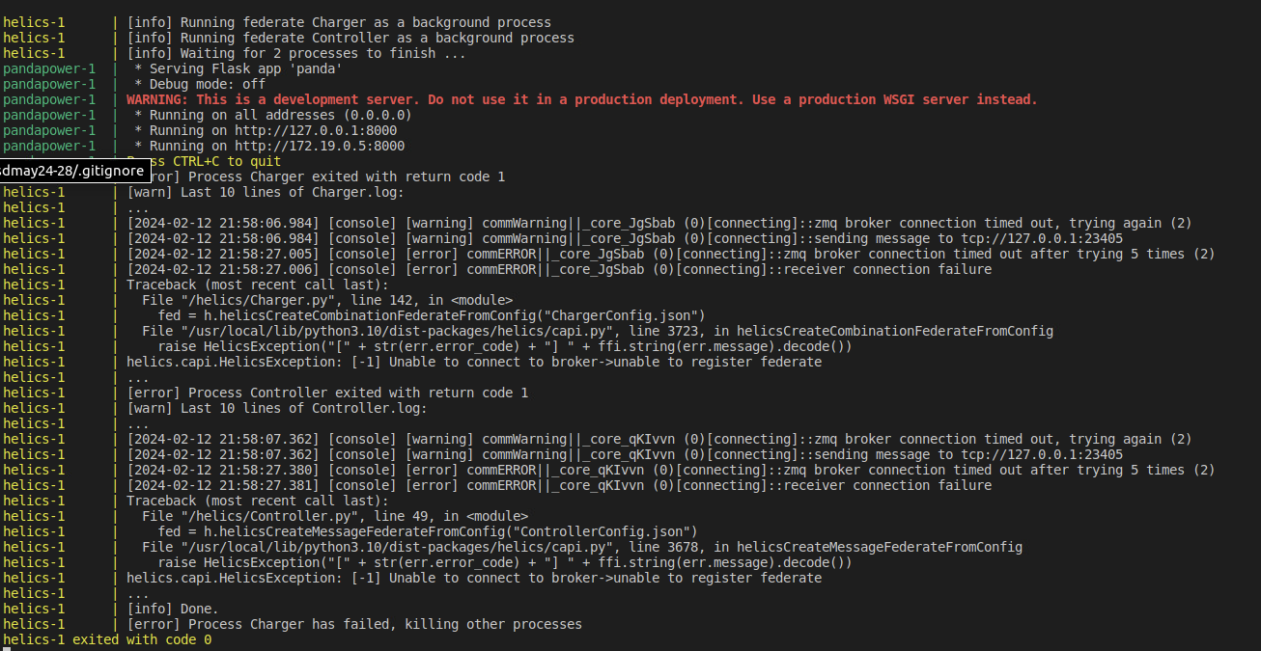
Justin - Work

Slide 6
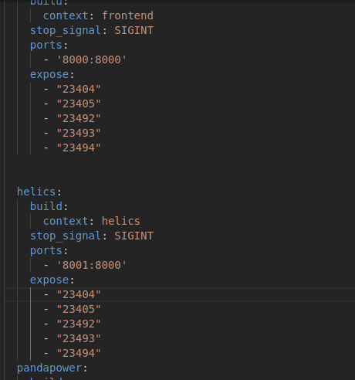
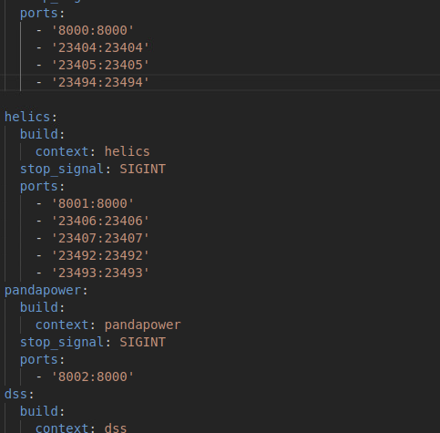
Justin - Work

Slide 7
Justin - Work
Whats Next?
Meet with Professor Ravikumar in order to clarify how HELICS runs on the Dockers
Maybe get Rolf involved if needed

Slide 8
Kaya - Work
Worked with Justin to continue figuring out getting Helics working with the Docker. Possibly a port problem?
Worked with Matt regarding 3 federate examples. Helics advanced examples have some 3 federate examples. Ran into plotting issue, but Matt figured it out. Never finishes, but produces pictures.
Ran the multi_computer example to verify Justin’s errors. It randomly works and randomly errors out. My error tends to be that it’ll just never finish and get stuck on a process.

Slide 9
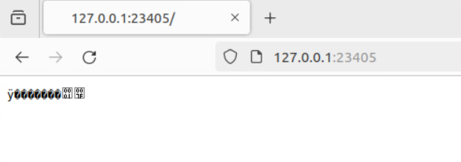
Kaya - Work
Ran advanced example web version, but it gets stuck on some process.

Slide 10
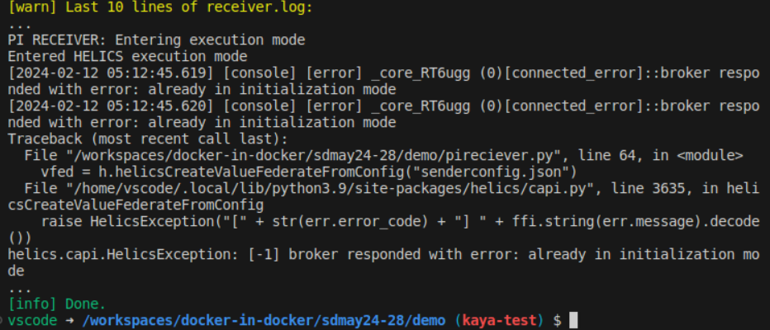
Kaya - Work
More exploring through the other examples, found electric grid simulations in the misc folder. Includes 3 examples, ⅔ include EV controllers. Uses gridlab-d, which isn’t installed, so cannot run. Worth installing to see how it works?
Attempted to implement bi-directional communication in the pireceiver and pisender example.

Slide 11
Tyler - Work
Got with the team to re-evaluate our plan going forward based on a switch from an emulation to a simulation mindset.
Started looking into papers provided from CprE 539 from Stuxnet, the Ukranian grid incident, and an IEEE excerpt from Professor Govindarasu’s reseach to get more of an idea of end outcomes of attacks (opening breakers, false data injection, poor data input validation, etc.) to have better ideas of what red team can accomplish.
Also talked with the team about possibilities such as changing generator values, causing cascading failures due to frequency imbalance, load shedding, etc. and how to accomplish them. Zach and I were thinking about making our own 4 bit control signal to cause certain effects depending on what bits are turned on in the signal.

Slide 12
Tyler - Work
Looking into Pandapower documentation, I found that there are functions for state estimation, which can be affected by false data injection attacks.
Step 7 shows that the control signal/action can activate the action of opening the breakers, which would then simulate what happened in the Ukrainian attack (this was the primary mission of the attackers).
Screenshot from https://ieeexplore.ieee.org/document/6032699

Slide 13
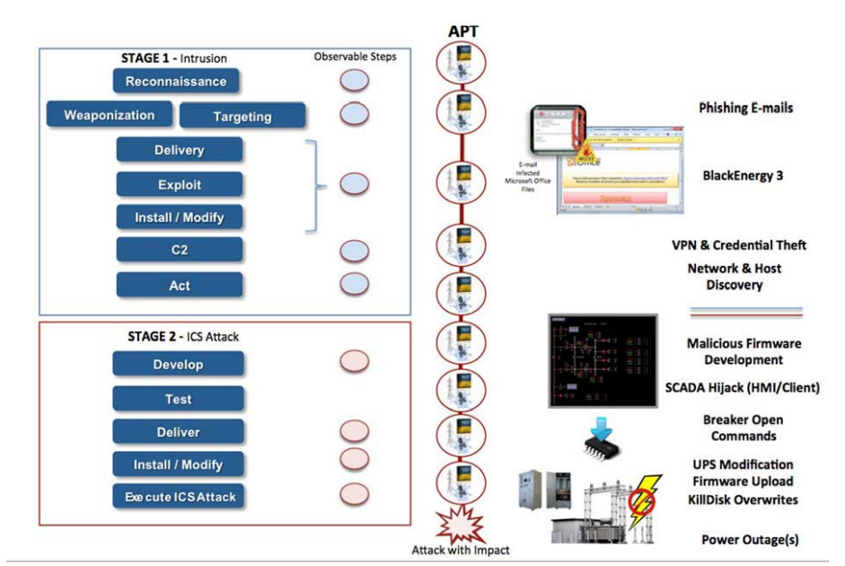
Tyler - Work
Screenshot from https://nsarchive.gwu.edu/sites/default/files/documents/3891751/SANS-and-Electricity-Information-Sharing-and.pdf

Slide 14
Tyler - Work
Finally, talked with Zach about how we can make the frontend show more of the scope and impacts of the attacks and we came up with the ideas of doing risk assessments and creating attack trees.

Slide 15
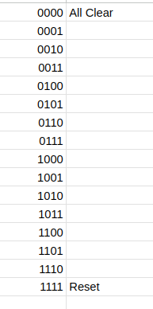
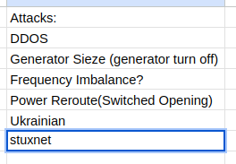
Zach - Work
Worked with Tyler and Tommy on what different common attacks/malfunctions for a grid would look like.

Slide 16
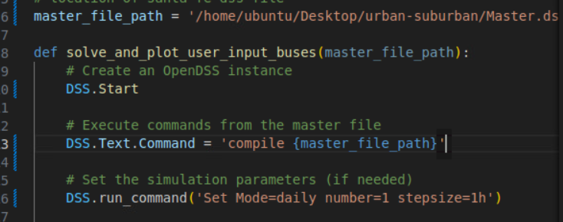
Zach - Work
Helped Tommy try to figure out an import error with DSS
DSS was getting confused because of another file named DSS.py
Continued with assisting Tommy resolve errors
The documentation is garbage for Python version of DSS compared to the COM version Link correct api for PyDSS

Slide 17
Zach - Future
HELICS has examples of presetup grids w/ EVs, etc
Kaya, Tyler, and I are gonna work on setting one up to start experimenting with simulating attacks and malfunctions
https://github.com/GMLC-TDC/HELICS-Examples/tree/main/user_guide_examples/misc/gridlabd_example_1

Slide 18
Matt - Work
Worked with Kaya on the advance example with three federates
Encountered a “duplicate broker name” error that went away when re-running the program
Although it went away, what is this error?
Ran into another error in plotting the outputs.

Slide 19
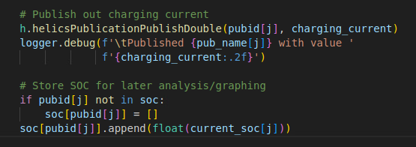
Matt - Work
Was able to fix this error by storing the SOC battery data in a pub, where as the example code was trying to store it as a sub.
Before:
Fixed:

Slide 20
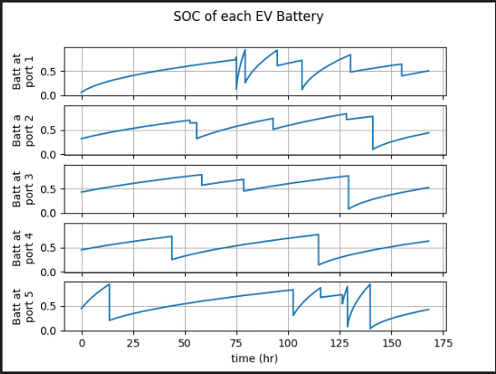
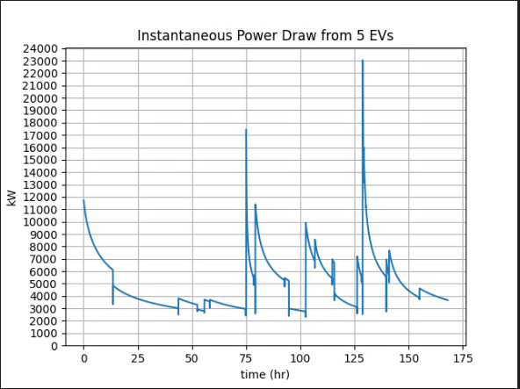
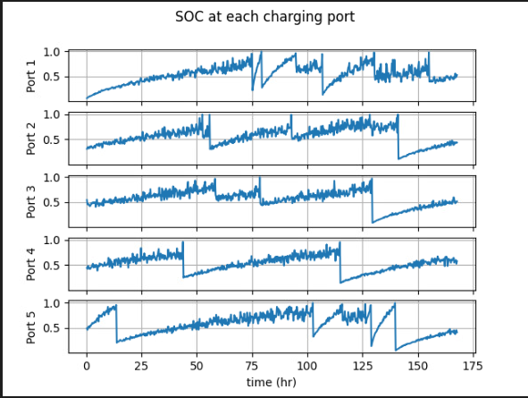
Matt - Work
Got output graphs of simulation with a battery, charger, and controller (system contains 5 EVs)

Slide 21
Matt - Work
continue exploring the advanced Helics example and explore different charger configurations and different numbers of EVs with different charging ports.

Slide 22
Tommy-Work
Worked with attack team to discuss the physical attacks on the grid and what outcomes we would see
Generator Attack
Switch manipulation
Frequency imbalances
Continued working on DSS-python and OpenDER collaboration
Still having trouble having dss run properly
DER works individually but can not get DSS to work so collaboration is not working currently

Slide 23
Tommy Work
Worked with Zach in resolving DSS errors and try to get it to work
Found out was using wrong codes(Zach helped me find correct documentation)
https://dss-extensions.org/python_apis.html
Tested and made sure programs were properly downloaded
Came to conclusion that minor errors in my written code are causing issues
Next Week's Plan
Work with Zach to get more in depth understanding of the coding side of DSS and come to next meeting with a working model of a DSS grid with DER BESS capabilities

Slide 24
Next Week's Plan
Mini milestone by end of February: end-to-end working system with data transfer between transmission, distribution, Helics
Exchanging voltage and current via Helics
Sante Fe connected to EV load in Helics

Slide 25
Meeting Minutes
Justin (4:30 - 4:42)
Kaya (4:42-4:52)
Matt (4:52-5:02)
Tyler (5:02-5:12)
Zach (5:12-5:18)
Tommy (5:18-5:25)

